Slide 1
CSE231 – Digital Logic Design
Brief introduction to Sequential Circuits
and
Latches

Slide 2
Sequential Logic Circuits

Slide 3
Sequential Logic Circuits
Combinational Logic Circuits
  Output is a function of the inputs only.
  Do not have “history”
Sequential Logic Circuits
  Output is a function of the inputs and the present state.
  Have “history”
  Maintain state information
  Require memory elements

Slide 4
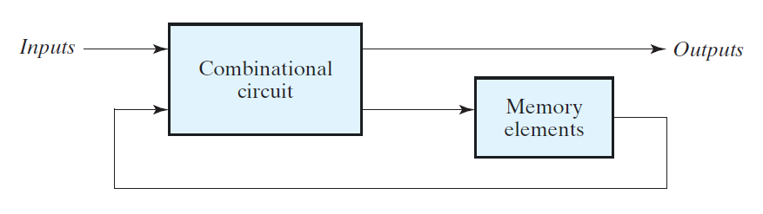
Sequential Logic Circuits

Slide 5
Basic Memory Elements

Slide 6
Basic Memory Elements
Latch
  Clock input is level sensitive.
  Output can change multiple times during a clock cycle.
  Output changes while clock is active.
Flip Flop
  Clock input is edge sensitive.
  Output can change only once during a clock cycle.
  Output changes on clock transition.

Slide 7
Basic Memory Elements
Both latches and flip flops use feedback to achieve “memory”.

Slide 8
SR Latch
(NOR gate implementation)

Slide 9
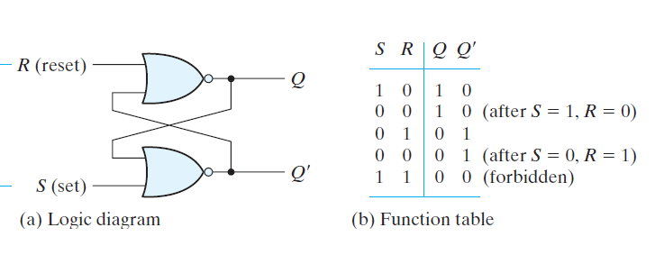
SR Latch
Q_{a}
Q_{b}
Q_{a}
Q_{b}

Slide 10
SR Latch
Resetting the SR Latch
(Qa = 0)

Slide 11
SR Latch: S = 0, R = 1
S = 0, R = 1
t
1
t
2
t
3
t
4
t
5
t
6
t
7
t
8
t
9
t
10
1
R
0
1
S
0
1
Q
a
?
0
1
Q
b
?
0
Time
Qa = 0
Qb = 1
R = 1 → Qa = 0
S = 0 & Qa = 0 → Qb = 1
Latch is reset.

Slide 12
SR Latch
Setting the SR Latch
(Qa = 1)

Slide 13
SR Latch: S = 1, R = 0
S = 1, R = 0
t
1
t
2
t
3
t
4
t
5
t
6
t
7
t
8
t
9
t
10
1
R
0
1
S
0
1
Q
a
?
0
1
Q
b
?
0
Time
Qa = 1
Qb = 0
S = 1 → Qb = 0
R = 0 & Qb = 0 → Qa = 1
Latch is set.

Slide 14
SR Latch
Storing the value in the SR Latch
(Qa⁺ = Qa)

Slide 15
SR Latch: S = 0, R = 0; Qa = 0
S = 0, R = 0
t
t
t
t
t
t
t
t
t
t
1
2
3
4
5
6
7
8
9
10
1
R
0
1
S
0
1
Q
a
?
0
Qa = 0
1
Q
b
?
0
Time
Qa = 0
Qb = 1
S = 0 & Qa = 0 → Qb = 1
R = 0 & Qb = 1 → Qa = 0
Behavior of latch is consistent.
Latch stores the
value of Qa

Slide 16
SR Latch: S = 0, R = 0; Qa = 1
S = 0, R = 0
t
t
t
t
t
t
t
t
t
t
1
2
3
4
5
6
7
8
9
10
1
R
0
1
S
0
1
Q
a
?
0
1
Q
b
?
0
Time
Qa = 1
Qa = 1
Qb = 0
S = 0 & Qa = 1 → Qb = 0
R = 0 & Qb = 0 → Qa = 1
Behavior of latch is consistent.
Latch stores the
value of Qa

Slide 17
SR Latch
The undefined state of the SR Latch
(Qa = Qb = 0)

Slide 18
SR Latch: S = 1, R = 1
S = 1, R = 1
t
1
t
2
t
3
t
4
t
5
t
6
t
7
t
8
t
9
t
10
1
R
0
1
S
0
1
Q
a
?
0
1
Q
b
?
0
Time
Qa = 0
Qb = 0
S = 1 → Qb = 0; R = 1 → Qa = 0

Slide 19
SR Latch: S = 1, R = 1
S = 1, R = 1
t
1
t
2
t
3
t
4
t
5
t
6
t
7
t
8
t
9
t
10
1
R
0
1
S
0
1
Q
a
?
0
1
Q
b
?
0
Time
Qa = 0
Qb = 0
S = 1 → Qb = 0; R = 1 → Qa = 0

Slide 20
SR Latch: The undefined state
What if both S and R transition from 1 to 0
at the same time?
(S = 1 → 0 & R = 1 → 0)

Slide 21
SR Latch: The undefined state
S = 1 → 0
R = 1 → 0
t
1
t
2
t
3
t
4
t
5
t
6
t
7
t
8
t
9
t
10
1
R
0
1
S
0
1
Q
a
?
0
1
Q
b
?
0
Time
Qa = ?
Qb = ?
If S and R both transition to 0 simultaneously,
  Output is unpredictable
  Dependent on speed of the 2 NOR gates.

Slide 22
SR Latch
(NAND gate implementation)

Slide 23
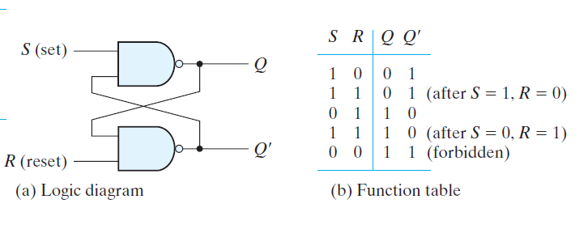
SR Latch

Slide 24
Gated SR Latch
(NAND Gate Implementation)

Slide 25
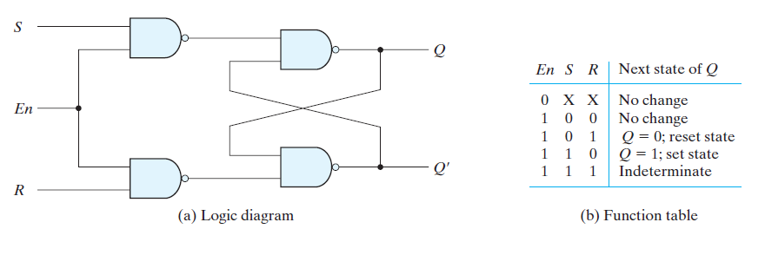
Gated SR Latch
S'
R'

Slide 26
Gated SR Latch: State Equation
State Equation: Q⁺ = S + R'.Q
  Q is the present (or current) state.
  Q⁺ is the next state.
    After the transition of the output Q.
  The next state is a function of the inputs and the present state.
    Inputs: S and R
    Present State: Q
  Note: Q is also denoted as Q(t)
  and Q⁺ is also denoted as Q(t+1).

Slide 27
Gated D Latch

Slide 28
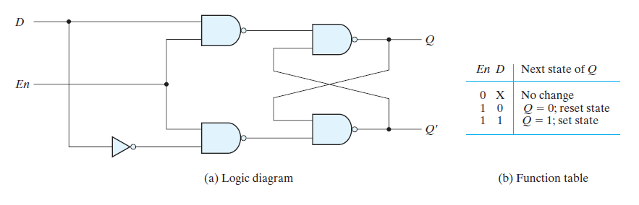
Gated D Latch
S
S'
R
R'

Slide 29
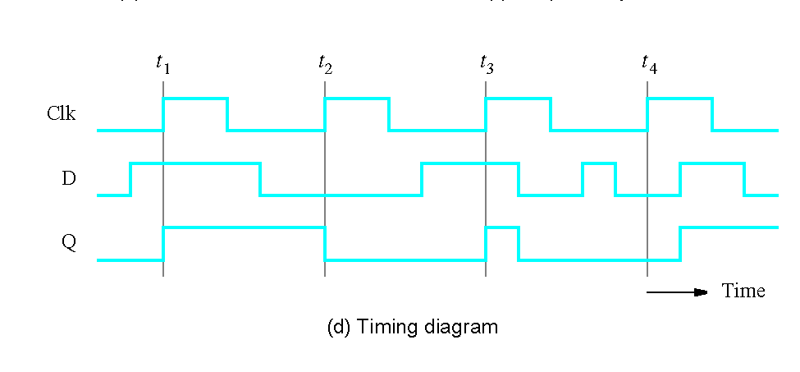
Gated D Latch: Clk = 0
Clk = 0
Clk = 0 → S' = R' = 1
S' = R' = 1 → Q⁺ = Q
  Next state = present state
Latch stores the
value of Q

Slide 30
Gated D Latch: Clk = 1
Clk = 1
Clk = 1 → S' = D', R' = D
S' = D', R' = D → Q⁺ = D
  Next state = input
Output (Q) follows
the input (D)

Slide 31
Gated D Latch
State Equation: Q⁺ = D
  Q⁺ is the next state
  D is the input
Eliminates the unstable case
  S' = R' = 0 cannot occur.
    S' = R' = 0 is the same as S = R = 1.
  The values of S' and R' are always complementary when the clock is high (active).

